Slide 1
Introduction to Finance Chatbot Fine-Tuning

Slide 2
Project Objectives
Students will build an intelligent bot that can engage with users by answering questions and providing insights specific to a chosen industry using state-of-the-art pre-trained models from Hugging Face.

Slide 3
Loading Datasets
Loaded datasets from various sources, ensuring they are in the correct format and ready for preprocessing and transformation.

Slide 4
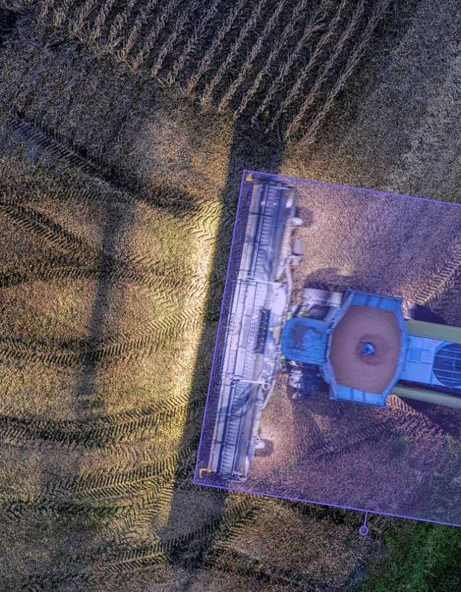
Applying Transformations
Applied necessary transformations to the datasets to adapt them to the requirements of the training pipeline.

Slide 5
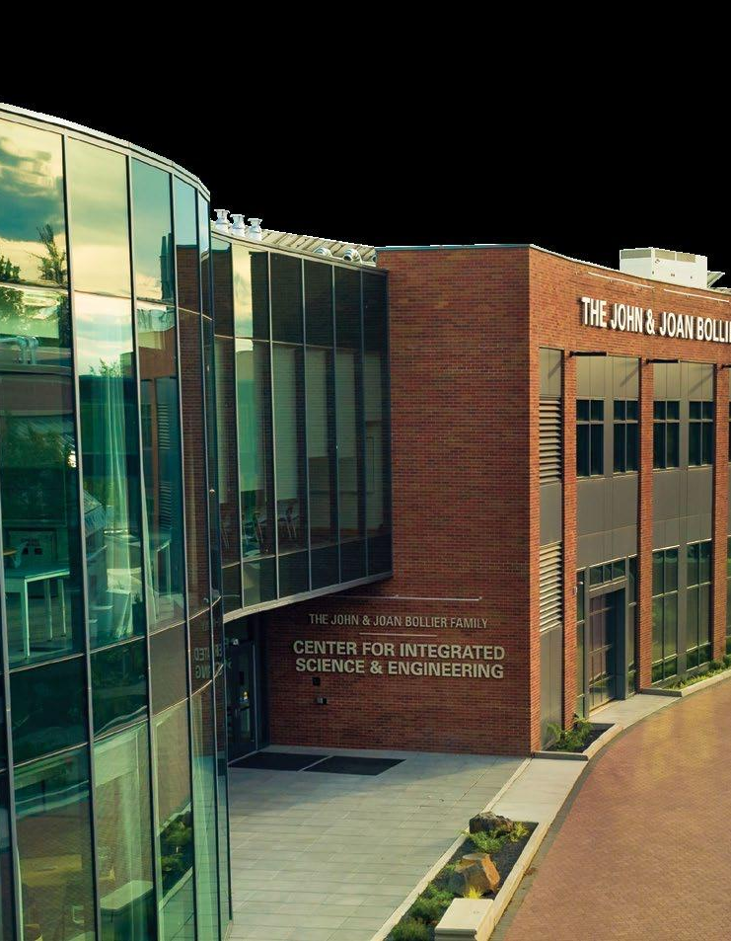
Industry Selection
Students must select one industry from the list provided. This industry will be the focus of their project, including data collection and model training.

Slide 6
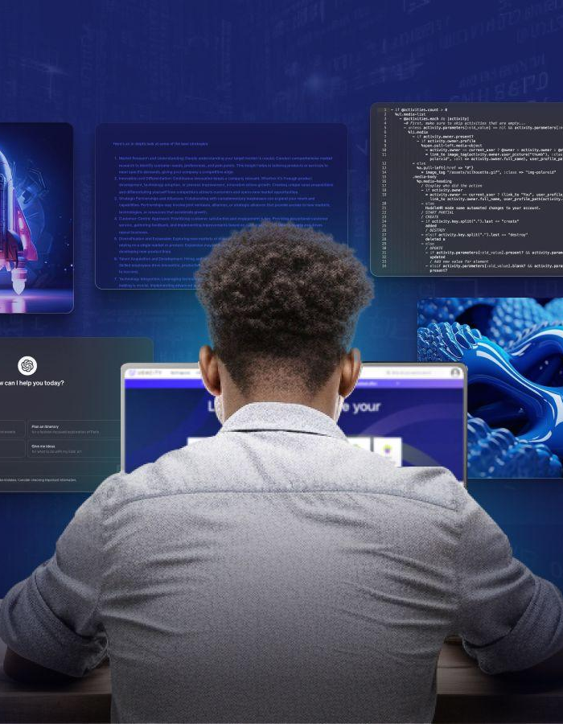
Data Collection and Model Training
Gather relevant data for fine-tuning the pre-trained model. Utilize resources like Google Colab with T4 GPUs, with a limit of 25 epochs for feasibility.

Slide 7
Bot Development and Demonstration
Develop the LLM Bot to interact with users, answering industry-specific questions. Create an explanatory video showcasing its practical application.

Slide 8
Workflow Overview
This presentation covers the workflow involved in fine-tuning a finance chatbot using datasets from different sources, combining data, applying transformations, and saving the trained model.

Slide 9
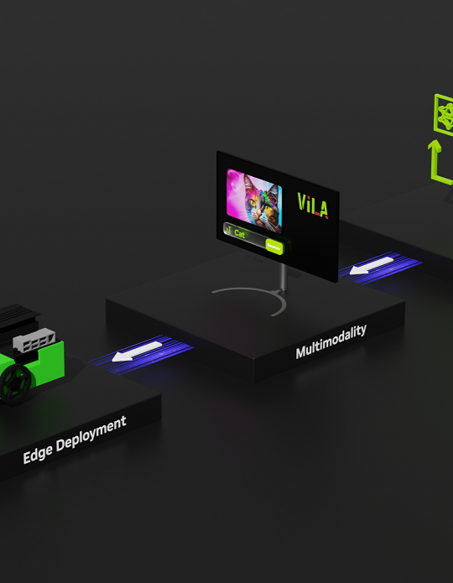
Datasets Used
We used two primary datasets: 'finance-alpaca-1k-test' and 'alpaca_finance_en'. These datasets were complemented by combining 'instruction' and 'output' columns into a 'text' column.

Slide 10
Dataset Industry
The datasets pertain to the financial industry, encapsulating various financial instructions and outputs to train robust chatbot models.

Slide 11
Model Operations
We employed the Llama-2-7b model, utilizing QLoRA for efficient training, setting different training parameters, and finally saving and fine-tuning the model.

Slide 12

Executing the Code
Code execution involves setting encoding, retrieving tokens, logging in, loading data, performing splits, merging datasets, and applying various transformations and training operations.

Slide 13
Conclusion
Successfully fine-tuned the finance chatbot, deployed the model, and documented the workflow for future reference and enhancements.

Slide 14
Data Preprocessing
Data preprocessing involved combining text columns from the datasets and removing irrelevant columns to form a clean, usable dataset for training.

Slide 15
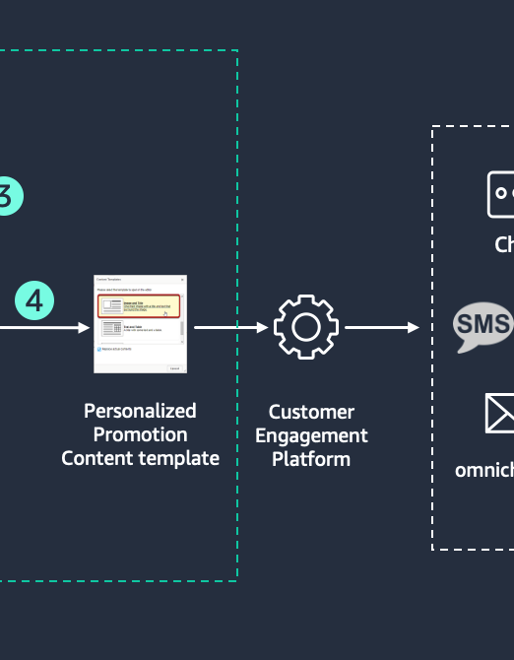
Train-Test Split
We performed a train-test split on the datasets to ensure the model is trained on one subset and validated on another, enhancing model performance and validation.

Slide 16

Merged Dataset
The datasets were merged into a single DatasetDict for streamlined handling and processing before feeding into the model.

Slide 17
Transforming Data
Applied text transformations to the dataset, segmenting it into prompts and responses to fit the conversational model format.

Slide 18

Setting Encoding
Set the preferred encoding to UTF-8 to ensure consistent and error-free handling of text data across the workflow.

Slide 19
Token Retrieval
Retrieved necessary tokens from secure storage for authentication and accessing external APIs and services.

